Slide 1
MENA-HPF HTA Online Platform
Notes:
Good afternoon.
I am Ahmad Fasseeh a Health Economist at Syreon Research Institute, we worked with the MENA Health Policy Forum to develop an online HTA platform.
The platform is meant to act as a regional knowledge and experience exchange hub in the field of Health Technology Assessment (HTA).
The platform is available as a website and a mobile application.

Slide 2
Structure
Notes:
I will walk you through the different sections of the platform briefly.

Slide 3
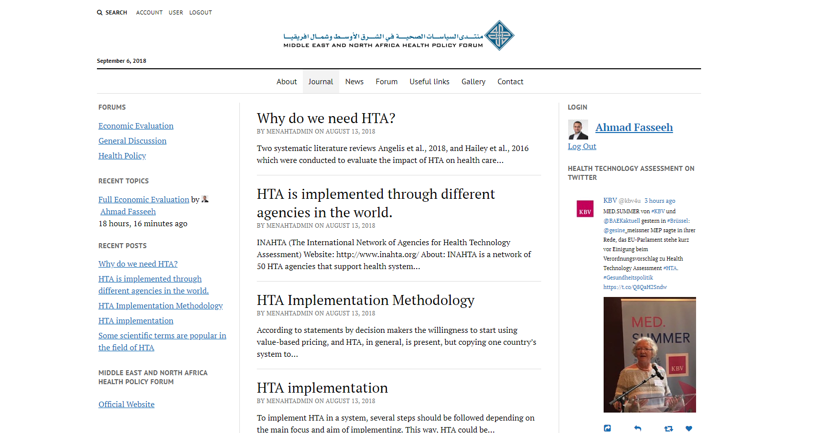
Notes:
When you open the website, This is what you see.
1- here you can navigate throughout the different sections of the platform. we will go through those sections one by one.
2- to the right side you can find recent tweets about Health Technology Assessment.
3- to the top left or at the bottom of the page you can find the search button which enables you to search the whole content of the platform
4- similar to other websites you can manage your account or log out at the top of the page

Slide 4
About
Notes:
The first section is the About section which contains a brief about MENAHPF, MENAHPF Organization, as well as a description of this platform.

Slide 5
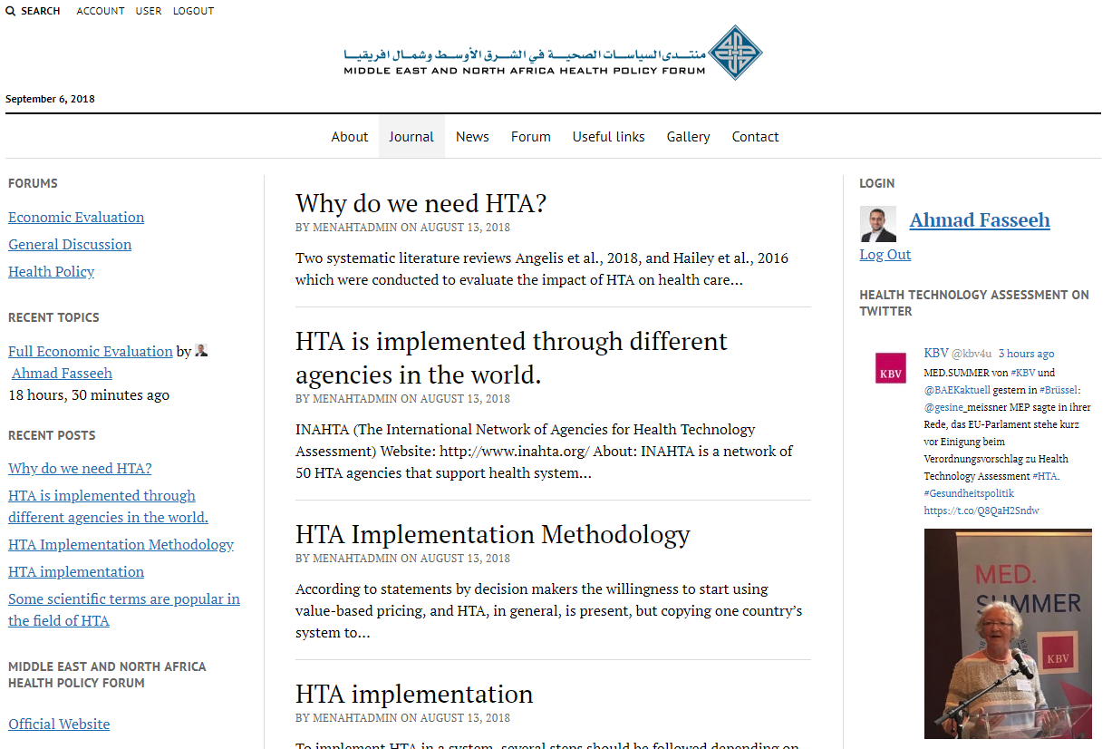
Journal
Notes:
The Journal is updated regularly with articles about Health Technology Assessment (HTA).

Slide 6
Journal – read full article
Notes:
To read the full article just click on the title.

Slide 7
Journal – comment
Notes:
At the end of each article you can find the comments section.
While the objective of the platform is to share knowledge and experience, we highly appreciate your contribution with comments to the journal, so everyone can benefit from the discussion.

Slide 8
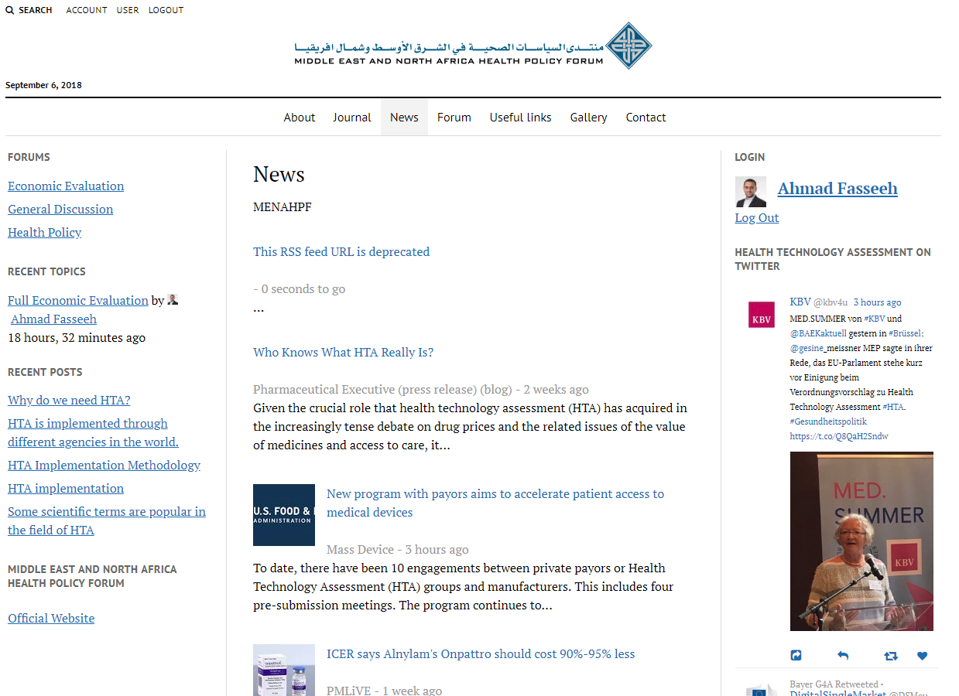
News
Notes:
The next section is the news section, which features a fresh collection of news about Health Technology Assessment from various sources all over the internet. Clicking on news headers redirects you to the original source to read the full topic.

Slide 9
Forum
Notes:
The forum is developed with the intention to exchange experiences, and knowledge between platform users.
All users can create a new topic or reply to others.
This section can be used either to open discussion related to topics you find interesting, or post questions you think others can help answer.

Slide 10
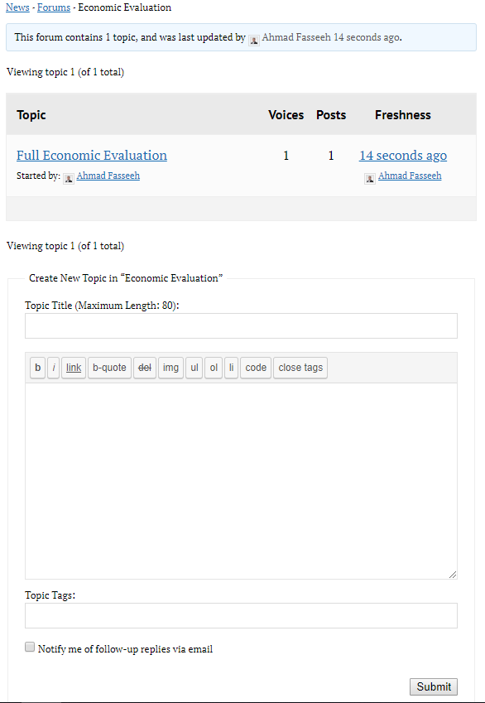
Forum cont.
Reply to other users topics
Create new topics on the forum
Notes:
Clicking on a topic title in the forum allows you to reply to it.
Below you can create new topics

Slide 11
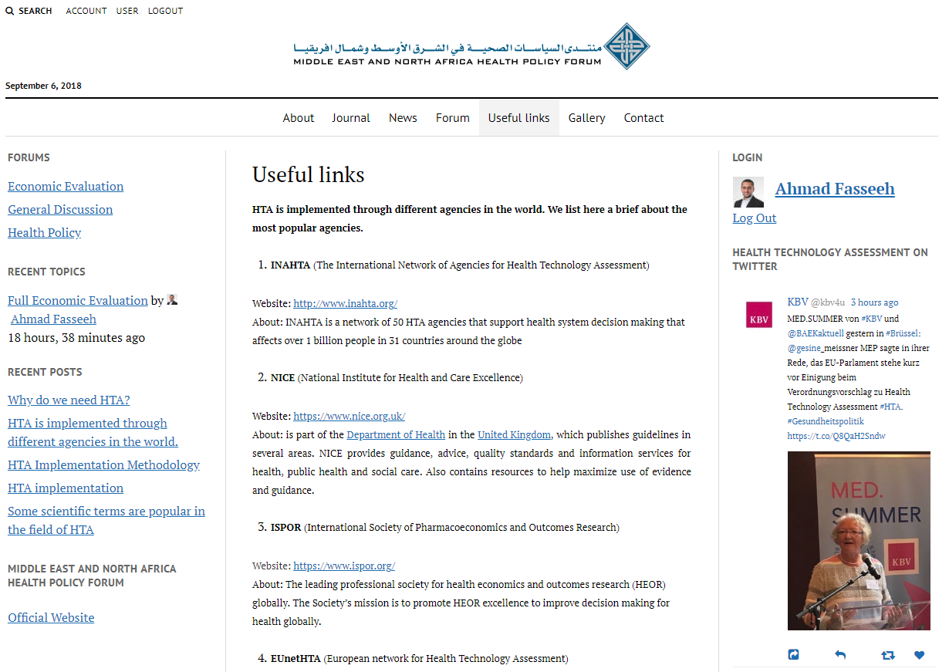
Useful links
Notes:
At the useful links tab you can find a bundle of links for useful resources on the internet related to Health Technology Assessment.

Slide 12
Contact us
You can find the contact details of the MENA-Health Policy Forum as well as a contact form to communicate with the platform admins.
Please use the contact form in case you have technical questions related to HTA or have suggestions related to the platform.
Notes:
In the contact us section You will find the contact details of the MENA-Health Policy Forum as well as a contact form to communicate with the platform admins.
Please use the contact form in case you have technical questions related to HTA or have suggestions related to the platform in general.

Slide 13
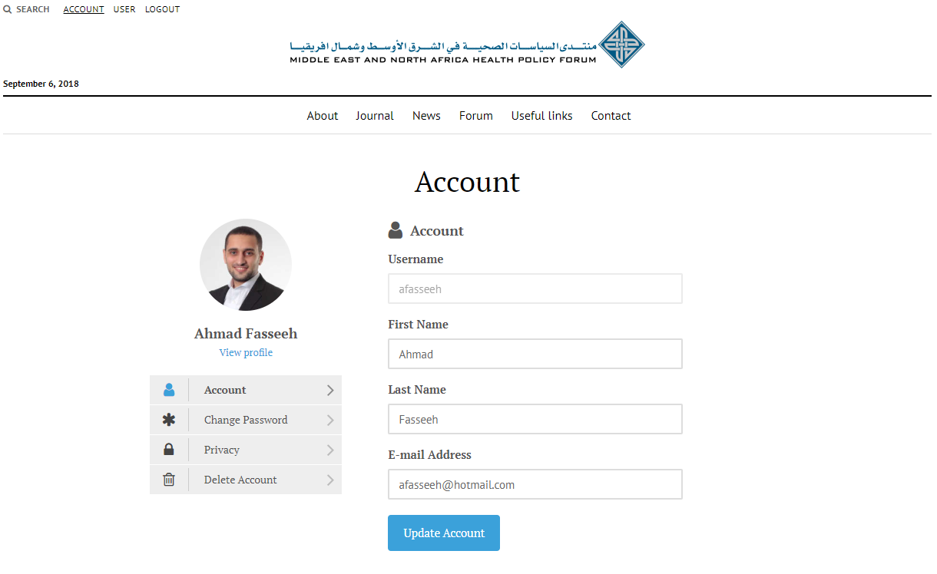
Manage account
Modify account details including:
Password
Profile photo
Email
Delete account
Notes:
You can manage your account similarly to other websites including changing your password, email, etc.

Slide 14
How to access the platform
Website available at www.MENAHTA.org
The mobile application is available on Android and iOS
Notes:
But how to access the platform. The platform is available at www.menahta.org it does not make a difference if you write it capitalized or not.
Also it is equal if you write the www. Or just menahta.org.
The mobile app is available on both Android and IOS

Slide 15
Registration
Notes:
Currently the platform is private and can only be accessed using a username and a password.

Slide 16
How to register for an account
To register you need to fill the form provided to you during the registration, indicating your willingness to join the platform.
Shortly after the conference, you will receive an email containing an invitation link (check your spam folder).
Follow the invitation link to register as a new user in the platform.
Notes:
To register you need to fill the form provided to you during the registration (This one), indicating your willingness to join the platform (Here). If you did not receive this form kindly raise your hands and we can circulate a paper where you can write your emails in.
Shortly after the conference, you will receive an email containing an invitation link (check your spam folder).
Follow the invitation link to register as a new user in the platform.

Slide 17
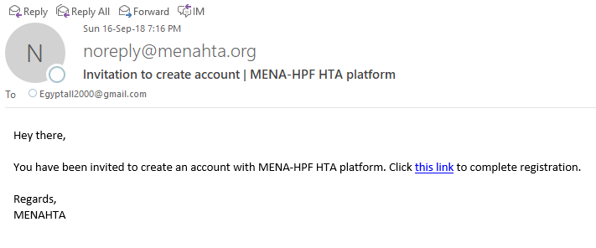
Notes:
This is similar to the email you should expect.

Slide 18
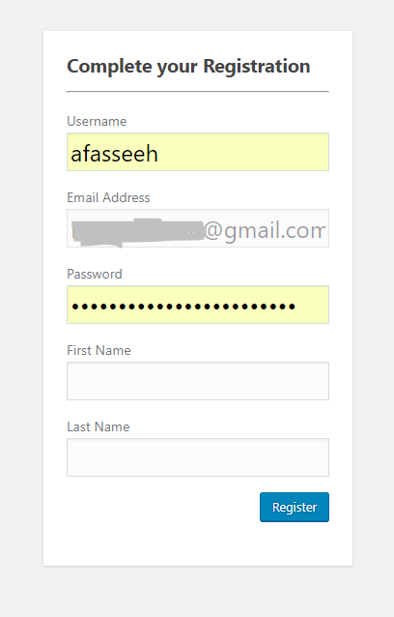
Notes:
You should complete your registration details.

Slide 19
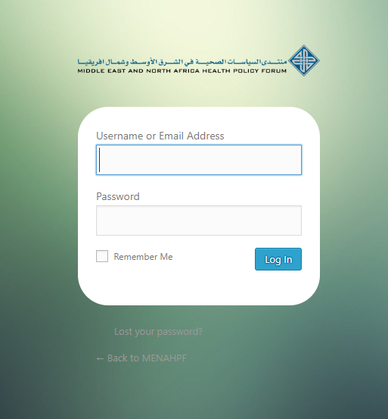
Log in page
Notes:
Then you can login to the website or mobile app and use the platform freely.

Slide 20
Mobile application

Slide 21
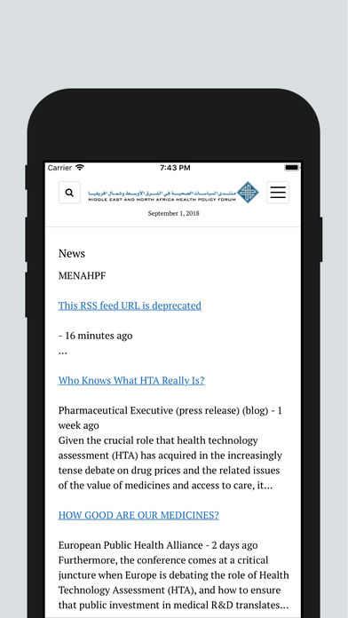
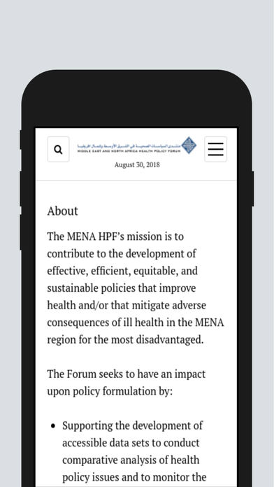
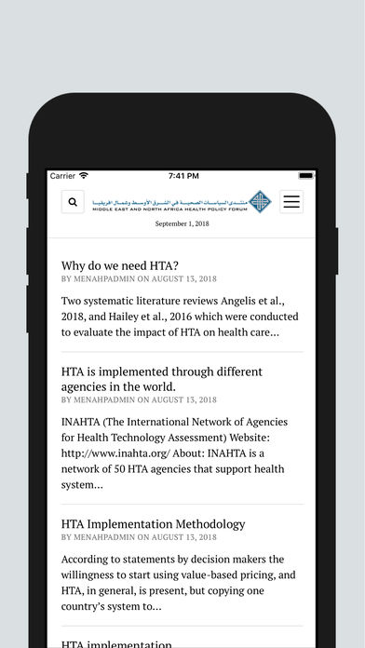
Mobile application

Slide 22
Download Mobile app
Available on
www.onelink.to/menahta
Notes:
To download the mobile app search for MENAHTA or open the following link www.onelink.to/menahta from the browser,
or you can scan the QR presented on the screen or within the distributed flyer.

Slide 23
Thank you

