Slide 1
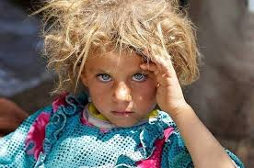
Integration of HTA into Public Policy
-Addressing burden of disease, future innovation for public health benefit-
Héctor E. Castro MD, PhD
Senior Technical Director
Photo credit: Rui Pires

Slide 2
OUTLINE
The challenges of sustainable UHC
Innovation and shifting BoD
Uncertainty of effectiveness & budget impact
Health as a human right
HTA and beyond…
Conclusions

Slide 3
The challenge of reaching (sustainable) UHC
Total Health Expenditure
OPTION 1
More resources
Height: what proportion of costs are covered?
Include services
Copayments
Extend base
Public spending
Depth: what benefits are covered?
Breadth: who is covered?
Source: The World Health Report (OMS, 2008), modified by HE, Castro 2014

Slide 4
The challenge of reaching (sustainable) UHC
Total Health Expenditure
OPTION 2
More efficient
Height: what proportion of costs are covered?
Include
services
copayments
Extend base
Public spending
Depth: what benefits are covered?
Breadth: who is covered?
Source: The World Health Report (OMS, 2008), modified by HE, Castro 2014

Slide 5
The challenge of reaching (sustainable) UHC
OPTION 3
Reach a social agreement
Total Health Expenditure
Height: what proportion of costs are covered?
Incluir servicios
copayments
Shrink base?
Depth: what benefits are covered?
Public
spending
Breadth: who is covered?
Source: The World Health Report (OMS, 2008), modified by HE, Castro 2014

Slide 6
On top of the usual challenges...
NEED to cope with technological and social pressure; increasing prices and epidemiological transition

Slide 7
Innovation and Shifting BoD
All health systems face challenge of finite resources vs. unlimited demand for services.
30 million deaths occurred in LMICs due to NCDs.
CVD, cancer, diabetes, and chronic lung diseases the 4 causes of NCD deaths.
R&D for NCDs proven to be effective and cost effective in many cases.
Uncertainty on effectiveness and cost of new, patented therapies may delay reimbursement and patient access,.

Slide 8
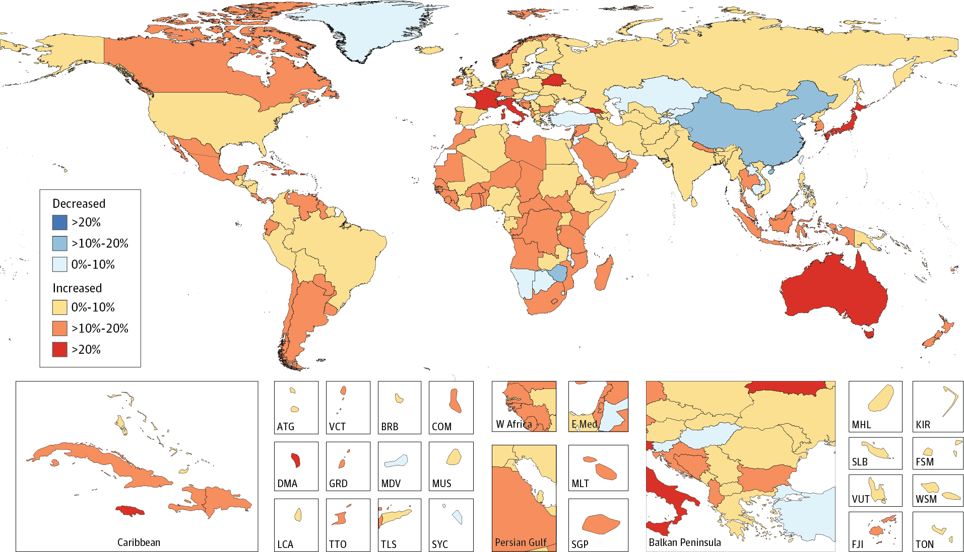
BoD- Cancer as way of example
Relative Changes in Age-Standardized Cancer Incidence Rates in Both Sexes for All Cancers in 195 Countries or Territories From 2005 to 2015
Fuente: https://jamanetwork.com/journals/jamaoncology/fullarticle/2588797
The WHO estimated 14 million new cases in 2012, next two decades to increase over 70%.
Cancer second leading cause of death globally, > 8,8 million deaths in 2015.
Notes:
When adding slides to your presentation, please use our branded fonts if possible: Garamond or Gill Sans. If these fonts are problematic, please use Calibri or Arial.

Slide 9
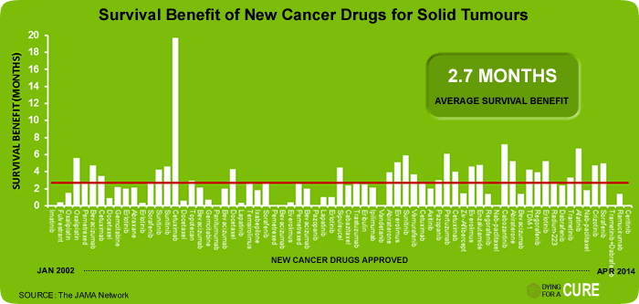
CANCER, UHC and worth doing innovation?
Notes:
When adding slides to your presentation, please use our branded fonts if possible: Garamond or Gill Sans. If these fonts are problematic, please use Calibri or Arial.

Slide 10
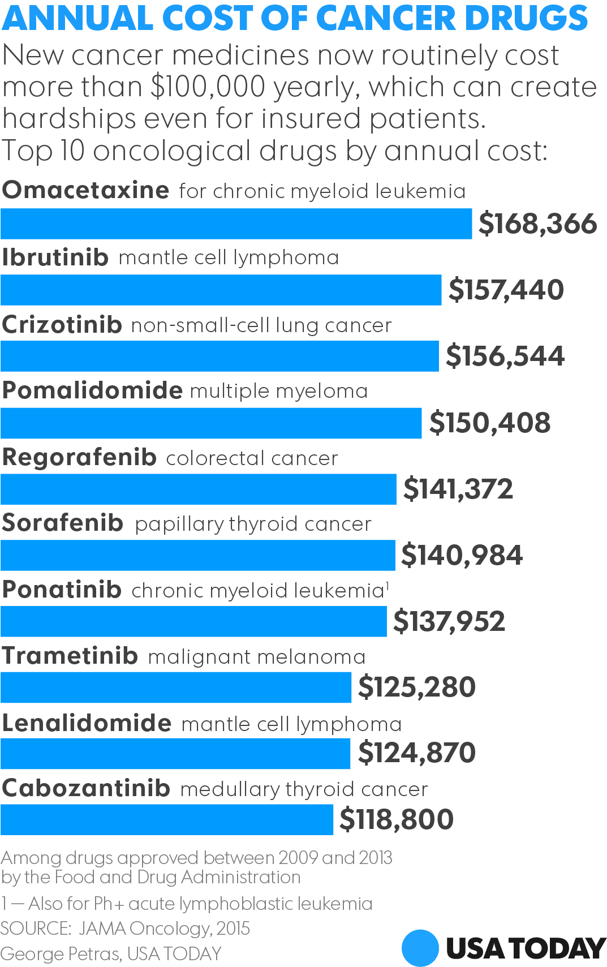
CANCER and increasing cost (prices)
Notes:
When adding slides to your presentation, please use our branded fonts if possible: Garamond or Gill Sans. If these fonts are problematic, please use Calibri or Arial.

Slide 11
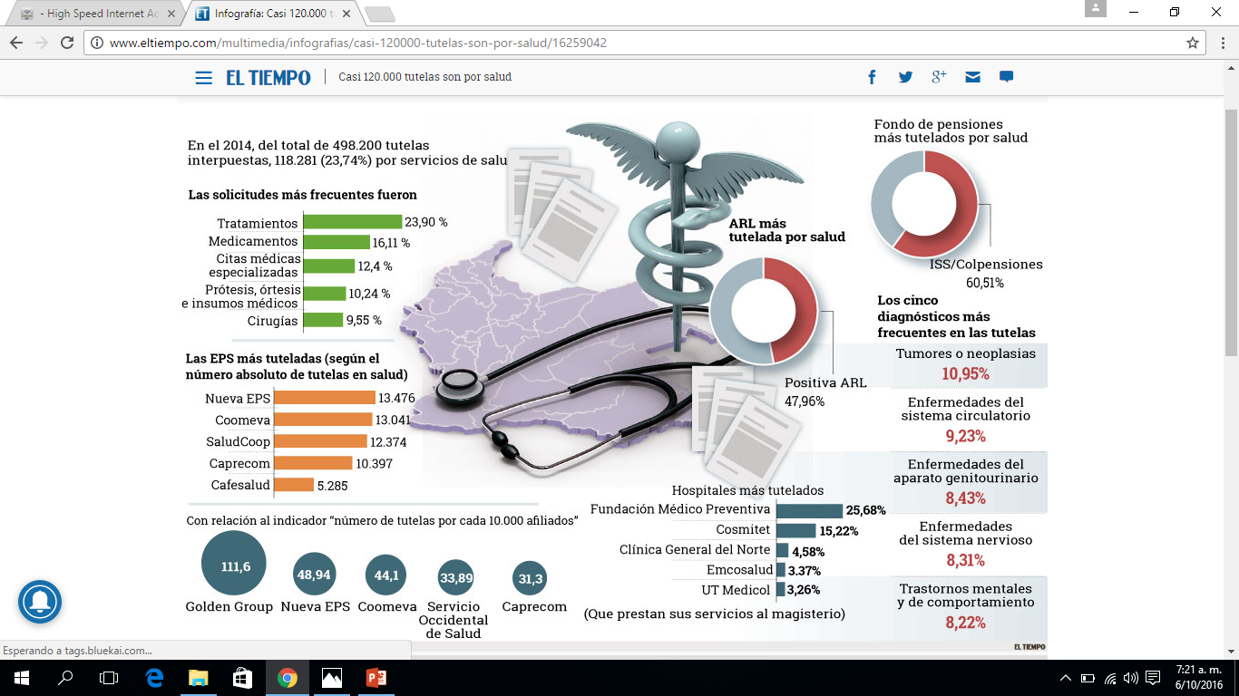
Health as a human right and ‘judicialization’ of access
In the case of Colombia, there is a judiciary claim every 5 minutes (120,000 per year) related to health/ health care
ACCOUNTABILITY
ARGUMENT?

Slide 12
Pricing and reimbursement approaches
Price regulation
International reference pricing
Internal reference pricing
Value based pricing.
Reimbursement
Benefits packages
Centralized negotiation/ procurement
Managed entry agreements
Need to align market authorization and HTA

Slide 13
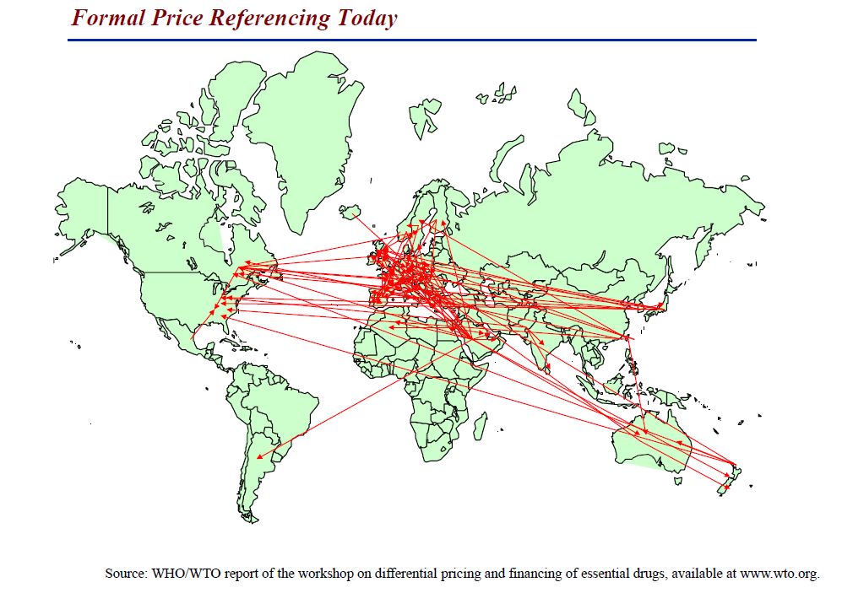
Pricing and reimbursement approaches -Limitations-
Limitations of IRP:
Data not always available
Collusion of market prices
Price opacity
Inflexible
Requires infrastructure

Slide 14
Pricing and reimbursement approaches -Limitations-
VMR
Control directo
Circular 03/2013
Source: Colombian MoHSP Feb, 2017.

Slide 15
Pricing and reimbursement approaches -the future-
Stewardship
Entry of new technologies
Coverage / reimbursement
Horizon scanning
Local needs vs producer´s pipeline alignment
Early dialogue with the industry
Therapeutic value assessment
Value based pricing
Prospective budgets Centralized negotiation
Managed Entry Agreements (MEAs)
Information systems
STRENHTENING THE ENTRY MECHANISM OF NEW HEALTH TECHNOLOGIES

Slide 16
Pricing and reimbursement approaches -the future-
Price ($)
Un regulated
IRP
Current treatment
VBP
Therapeutic categories:
Safer and more efficacious (++)
As safe or as efficacious, better in other dimension (+= or =+)
As safe and as efficacious (==)
Less safe or efficacious, same in other dimension (<= or =<)
Less safe and efficacious (<<)
Ex factory cost ($)

Slide 17
Pricing and reimbursement approaches -the future-
Opportunities for Managed Entry Agreements (MEAs):
Global trend to reach universal healthcare coverage
Budget constraints
Population transition towards more chronic conditions
Increasing social pressure and mood of accountability
Uncertainty of marginal benefit vs marginal cost of new drugs
Thus there is an opportunity for payers and developers to share risks

Slide 18
Taxonomy for MEAs
Source: Kanavos et al (2017)

Slide 19
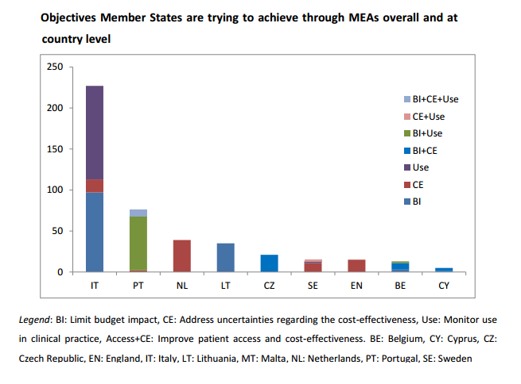
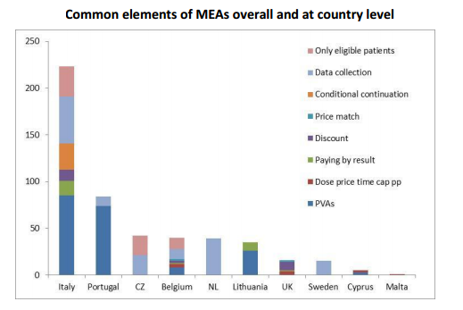
Opportunities for MEAs
Source: Ferrario and Kanavos, 2013

Slide 20
The potential use of MCDA
STEWARDSHIP OF PRIORITY SETTING POLICY
Topic selection Identify and select candidates for evaluation
MCDA
Appraisal Deliberation process and recommendations
MCDA
Marketing authorization
Technical assessment using robust methods and evidence summary
Budget impact analysis
Decision Making
Monitoring and Evaluation
INFORMATION SYSTEM
Source: Adapted from IDB, Colombia priority setting of public expenditure project, 2011 Adapted H, Castro 2013.

Slide 21
The potential use of MCDA
Weighting criteria of the MCDA Core Model
Cluster | Scientific criteria | Relative weight Low High | Should not be considered
Disease impact
D1 | Disease severity | 1 2 3 4 5 | 0
D2 | Size of population affected by disease | 1 2 3 4 5 | 0
Context of intervention
C1 | Clinical guidelines for intervention | 1 2 3 4 5 | 0
C2 | Comparative intervention limitations (unmet needs) | 1 2 3 4 5 | 0
Intervention outcomes
I1 | Improvement of efficacy/effectiveness | 1 2 3 4 5 | 0
I2 | Improvement of safety & tolerability | 1 2 3 4 5 | 0
I3 | Improvement of patient reported outcomes | 1 2 3 4 5 | 0
Type of Benefit
T1 | Public health interest (e.g., prevention, risk reduction) | 1 2 3 4 5 | 0
T2 | Type of medical service (e.g., symptom relief, cure) | 1 2 3 4 5 | 0
Economics
E1 | Budget impact on health plan (cost of intervention) | 1 2 3 4 5 | 0
E2 | Cost-effectiveness of intervention | 1 2 3 4 5 | 0
E3 | Impact on other spending (e.g, hospitalization, disability) | 1 2 3 4 5 | 0
Quality of evidence
Q1 | Adherence to requirements of decision making body | 1 2 3 4 5 | 0
Q2 | Completeness and consistency of reporting evidence (meeting scientific reporting standards and consistency with sources) | 1 2 3 4 5 | 0
Q3 | Relevance and validity of evidence (relevant to decision-makers & meeting scientific standards) | 1 2 3 4 5 | 0

Slide 22
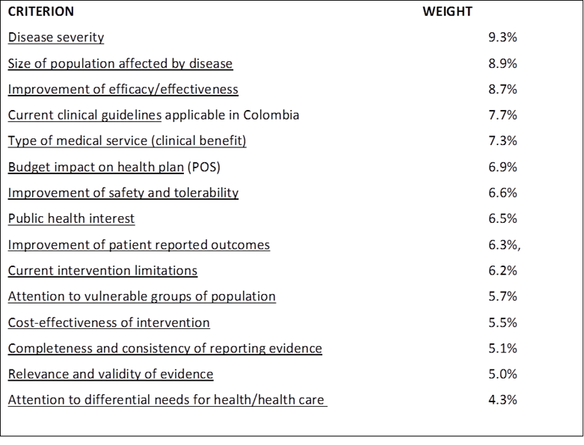
The potential use of MCDA
Final list of criteria and weights for Colombian-modified version of the EVIDEM
CRES in 2012 weighted relevant criteria
In 2013 (Castro) tested 4 technologies using CRES 15 contextualized criteria
EVIDEM promotes discussion
EVIDEM transparency of evidence and motives in which decisions are based

Slide 23
MCDA – PROMOTING INTERVENTIONS ACCORDING TO THEIR RELEVANCE IN ATTAINING THE triple aim OF HEALTHCARe
7- RANKING
8 – OPPORTUNITY COSTS & BUDGET MANAGEMENT
QUANTITATIVE MODEL
∑ (Weights X Scores)
QUALITATIVE MODEL
(e.g., cultural context)
Most beneficial intervention
Value = 1*
BUDGET IMPACT
A
B
$0.1M
High value: invest
Low value: disinvest
B
A
$1M
Contextual impact
Value of interventions
C
C
$0.1M
D
$1M
D
Least beneficial intervention
Value = 0
*Linear model for Value; Weights: 6 direct weights elicitation techniques available in EVIDEM v3.0; Scores: generic constructed scales for each criterion (holistic comparability)
Deliberation, communication and implementation
Invest based on relevance and manage opportunity costs by means of a financial analysis

Slide 24
Final considerations
Advancing towards UHC is very challenging, but (arguably) being fair and sustainable could be even more.
The demographic transition, shifting BoD, technological and social pressure alongside price discrimination in LMICs add to the UHC challenge.
Explicit priority-setting and the use of HTA improves the use of limited resources by maximizing health benefits.
Besides informing EML and benefits packages, HTA could inform other public polices like value based pricing, centralized negotiations and risk sharing agreements, among others.
More efforts and resources should be devoted for HSS in LMICs to improve their informed decision making for health care.

Slide 25
Thank you!
شكرا

