Slide 1
Access to Innovative Medicines in UHC: Advancing the Dialogue
Sarbani Chakraborty, Head, Public Policy, Eastern Europe, Middle East and Africa, (EEMEA), Roche

Slide 2
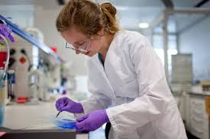
Do Innovative Medicines matter for UHC?
Growing middle class, public expectations for emerging markets' health systems are rising.
UHC coverage and implementation is weakest for NCDs, in spite of the fact that they represent the bulk of the disease burden in emerging markets.
Better option than traditional treatments – inclusion of patented medicines on WHO EML

Slide 3
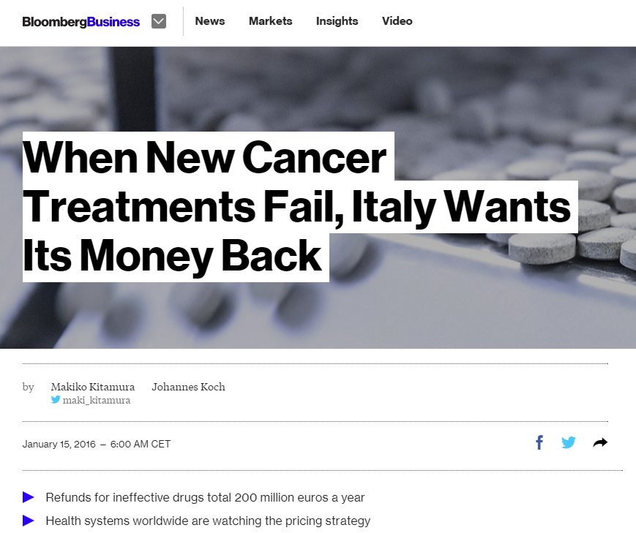
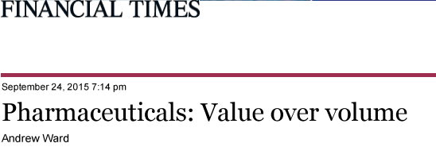
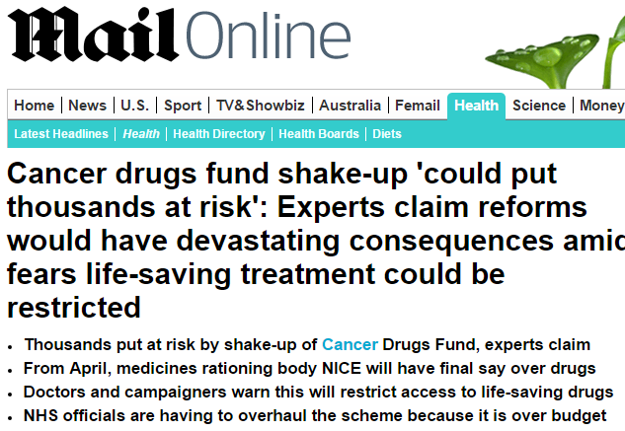
But people are worried about price
Sources: http://www.360mediawatch.com/videos/videos/53470/ASCO_CNBC_06-01_7am.mp4, http://meetinglibrary.asco.org/content/115302?media=vm

Slide 4
Governments
Industry
My biggest challenge in providing more access within limited budget
But investing in health care is securing social and economic value
Paying for outcomes sounds complicated. It will take too long to implement
It is important to look beyond medicines – improving efficiency of the system
We have so many needs – why would I reinvest my savings into innovative medicines
Governments can easily reinvest savings into innovative medicines
GOV./PAYERS and INDUSTRY have different views on access to innovative medicines but we need convergence for sustainability
Notes:
But the

Slide 5
Move to Value Based Approaches can improve the dialogue between Governments and the Private Sector
Transparent Methods to assess the value of health technologies (HTA)
Real World Data/Real World Evidence
Outcomes based payment approach
Notes:
But there is growing recognition led by some groups (WEF, EIU) that work on public-private partnerships that this is the way to go. Same for EU Governments as well as the US. Moving to Value based health care will be key for CCE countries and is a win-win for us as well. It will improve the dialogue between policy makers and industry, focus on patients and improve transparency. However. It will rqeuire a long-term committment by policy makers and other key stakeholders including us.

Slide 6
Micro- and macro-level HTA Towards a more efficient use of scarce HTA resources
micro-level” HTA, usually with focus on short term cost containment rather than any system wide focus on achieving value
appraisal of individual technologies, or groups of related technologies
“macro-level” HTA which is about the efficiency of the organizational system or architecture of the health care system e.g.
primary care and hospital infrastructure (size, accessibility, quality standards)
public/private contribution in health care provision and regulatory options
renumeration systems and provider incentives
→ A stronger focus of limited HTA resources on “macro” aspects of health system architecture may yield higher gains mid- to long term

Slide 7
Multi-criteria decision deliberation as the basis of politically accountable decision making
Example Belgium
Example Lombardy (Italy)
KCE Belgium 2016
Tringali 2014
“As in most of the other European countries, all of these criteria are used [in Belgium] to formulate a binary access decision (Class 1-3 granted) in a multiple criterion decision deliberation (MCDD) based on a holistic consideration of the criteria, rather than being the result of an explicit hierarchy or formal weighing of the criteria in a multiple criterion decision analysis (MCDA).”
van Dyck, de Graeve et al. 2016

Slide 8
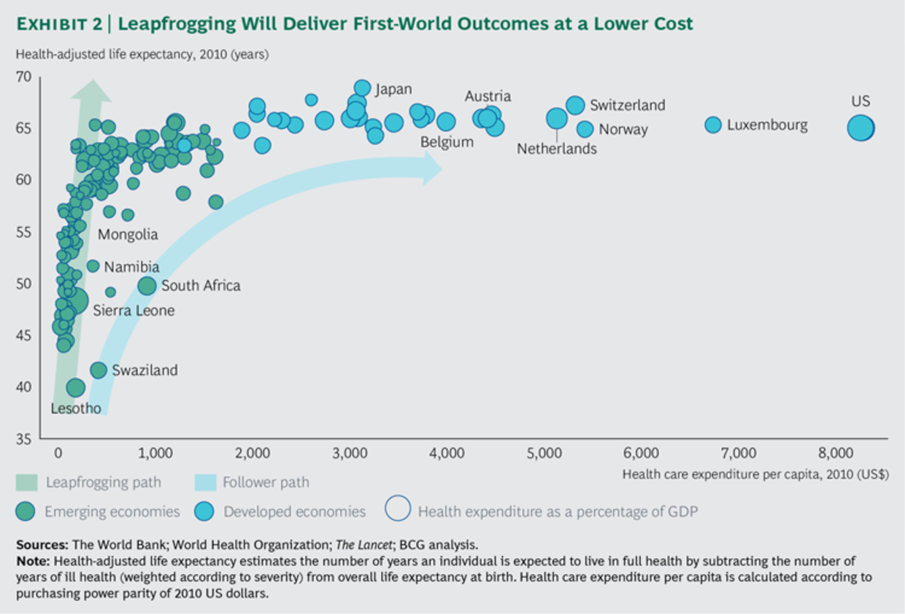
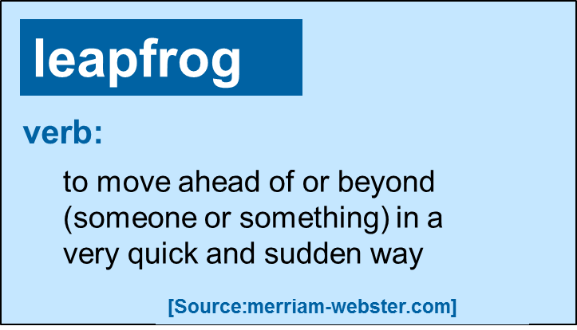
Will Emerging Markets Leapfrog into value-based health care
bcg.perspectives. leapfrogging 2016

